Slide 1
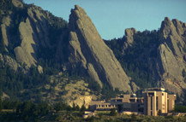
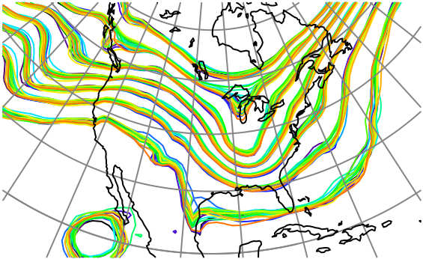

Methods for Computing Localization of Observation Impacts in Ensemble Kalman Filters
Jeff Anderson, NCAR Data Assimilation Research Section

Slide 2
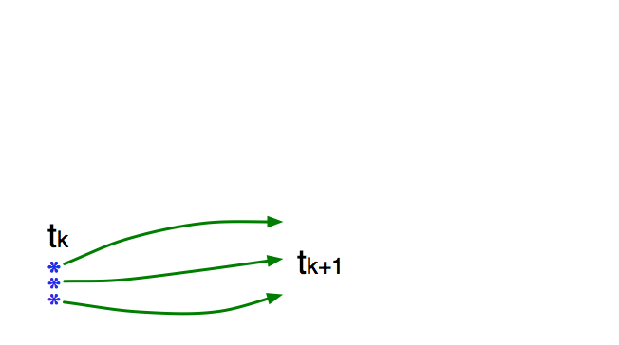
Schematic of an Ensemble Filter for Geophysical Data Assimilation
Use model to advance ensemble (3 members here) to time at which next observation becomes available.
Ensemble state estimate after using previous observation (analysis)
Ensemble state at time of next observation (prior)

Slide 3
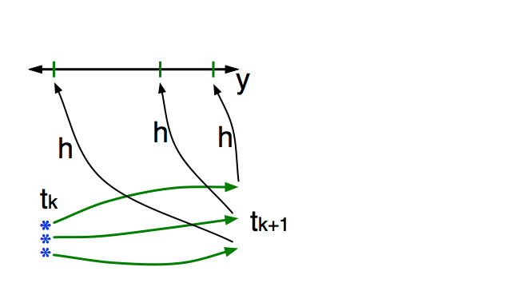
Schematic of an Ensemble Filter for Geophysical Data Assimilation
Get prior ensemble sample of observation, y = h(x), by applying forward operator h to each ensemble member.
Theory: observations from instruments with uncorrelated errors can be done sequentially.

Slide 4
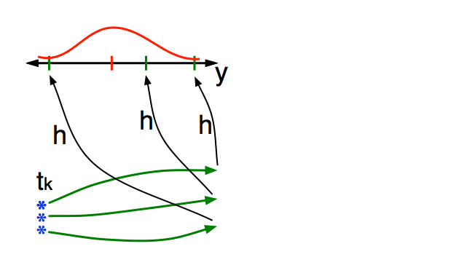
Schematic of an Ensemble Filter for Geophysical Data Assimilation
Get observed value and observational error distribution from observing system.

Slide 5
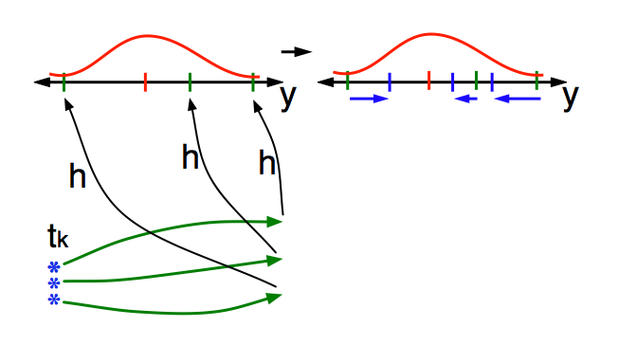
Schematic of an Ensemble Filter for Geophysical Data Assimilation
Find the increments for the prior observation ensemble (this is a scalar problem for uncorrelated observation errors).
Note: Difference between various ensemble filter methods is primarily in observation increment calculation.

Slide 6
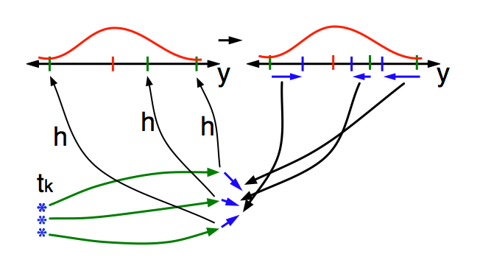
Schematic of an Ensemble Filter for Geophysical Data Assimilation
Use ensemble samples of y and each state variable to linearly regress observation increments onto state variable increments.
Theory: impact of observation increments on each state variable can be handled independently!

Slide 7
Schematic of an Ensemble Filter for Geophysical Data Assimilation
Use ensemble samples of y and each state variable to linearly regress observation increments onto state variable increments.

Slide 8
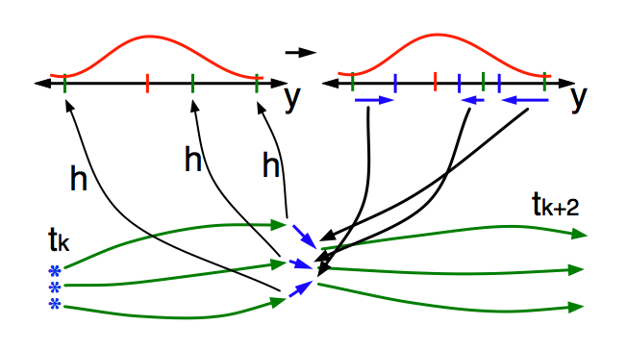
Schematic of an Ensemble Filter for Geophysical Data Assimilation
When all ensemble members for each state variable are updated, there is a new analysis. Integrate to time of next observation …

Slide 9
Focus on the Regression Step
Regress y increments onto each state component x_{i}.
Δx_{i,n}=bΔy_{n,}
n=1,…N.
N is ensemble size.
b is regression
coefficient.

Slide 10
Localization is Required for Most Applications
Localization multiplies regression.
Increments for N ensemble samples of x are:
Δx_{i,n}=αbΔy_{n,} n=1, …, N.
b is sample regression coefficient.
α is a localization (normally between 0 and 1).

Slide 11
Defining a Localization Function
Localization for a given (y, x) might be a function of:
Metadata for (y, x) such as:
Separation between (y, x),
Kind of observation y (temperature, wind, …),
Kind of state variable x.

Slide 12
Method 1: Best Tuned Gaspari-Cohn
Function of ‘separation’ between observation y and state x.
Length scale defined by halfwidth parameter.

Slide 13
Method 2: Optimized Localization
Get optimal localization:
Minimize RMSE in OSSE a posteriori.
Initial guess is best Gaspari Cohn.
Tricky optimization problem:
Expensive (many long OSSEs),
Noisy,
Possible multiple minima.

Slide 14
Method 3: Global Group Filter
Run a group of quasi-independent ensembles.
Compute and .
Compute optimal localization α for
this y and x_{i}.
…
…

Slide 15
Method 3: Global Group Filter
Run 200 groups for 3000 steps.
Do least squares fit for localization for each separation subset.
Resulting localization for each separation used with single ensemble.
Expensive to initialize.
…
…

Slide 16
Method 4: Correlation Error Reduction
Assume all errors are due to ensemble sampling error.
Focus on regression b=r(σ_{x}/σ_{y}),
r is correlation,
σ_{x} is standard deviation of state,
σ_{y} is standard deviation of observation.
Estimates of standard deviation are unbiased
(but estimates of ratio are biased, not discussed here).
Only correct sampling error in the correlation.

Slide 17
Method 4: Correlation Error Reduction
Define localization function for subsets of (y, x) pairs.
Examples:
All pairs separated by a given distance range,
All pairs where y is a temperature and x is a u-wind separated by a given distance range.

Slide 18
Method 4: Correlation Error Reduction
Overview of Algorithm:
Estimate ‘background’ correlation distribution for each separation subset.
Use current sample correlation from assimilation and associated sampling error uncertainty.
Combine current correlation with background.
Get ‘localized’ correlation to update state x.

Slide 19
Lorenz96 40-Variable Localization Subset Definition
Define subsets of (y, x) pairs by separation:
Example: state x is 3 grid intervals from observation y, (dx = 3).
Estimate localization distribution for each separation.

Slide 20
Example: L96 Infrequent High-Quality Observations
Identity observations, error variance 1.
Assimilate every 12th model timestep.
20-member ensemble.

Slide 21
Method 4: Correlation Error Reduction Algorithm
Start with prior estimate of correlation for a separation (dx = 3 here) between obs and state variable.

Slide 22
Method 4: Correlation Error Reduction Algorithm
Ensemble sample correlation between observation and state prior is part of standard ensemble algorithm.
Sample correlation here is 0.2.

Slide 23
Method 4: Correlation Error Reduction Algorithm
Likelihood for this sample correlation and ensemble size is computed off-line ahead of time.
It is probability of true correlation given the sample correlation.
Note skew to the left.

Slide 24
Method 4: Correlation Error Reduction Algorithm
Posterior is normalized product of prior and likelihood.
This is Bayes rule.

Slide 25
Method 4: Correlation Error Reduction Algorithm
Use mean value of posterior correlation, (0.1228 here) in the regression to update state.
An equivalent localization is 0.1228 / 0.2 = 0.614.

Slide 26
Method 4: Correlation Error Reduction Algorithm
Update prior correlation distribution by adding a small constant times the posterior and normalizing.
Results here use 0.001 for this constant.
This is the only free parameter in the algorithm.
This is NOT Bayes rule.

Slide 27
Evolution of Correlation Distribution

Slide 28
Evolution of Correlation Distribution

Slide 29
Evolution of Correlation Distribution

Slide 30
Evolution of Correlation Distribution

Slide 31
Evolution of Correlation Distribution

Slide 32
Evolution of Correlation Distribution

Slide 33
Evolution of Correlation Distribution

Slide 34
Evolution of Correlation Distribution

Slide 35
Evolution of Correlation Distribution

Slide 36
Evolution of Correlation Distribution

Slide 37
Evolution of Correlation Distribution

Slide 38
Evolution of Correlation Distribution

Slide 39
Evolution of Correlation Distribution

Slide 40
Evolution of Correlation Distribution

Slide 41
Evolution of Correlation Distribution

Slide 42
Evolution of Correlation Distribution

Slide 43
Evolution of Correlation Distribution

Slide 44
Evolution of Correlation Distribution

Slide 45
Evolution of Correlation Distribution

Slide 46
Evolution of Correlation Distribution

Slide 47
Evolution of Correlation Distribution

Slide 48
Evolution of Correlation Distribution

Slide 49
Evolution of Correlation Distribution

Slide 50
Evolution of Correlation Distribution

Slide 51
Evolution of Correlation Distribution

Slide 52
Evolution of Correlation Distribution

Slide 53
Evolution of Correlation Distribution

Slide 54
Evolution of Correlation Distribution

Slide 55
Evolution of Correlation Distribution

Slide 56
Evolution of Correlation Distribution

Slide 57
Evolution of Correlation Distribution

Slide 58
Evolution of Correlation Distribution

Slide 59
Evolution of Correlation Distribution

Slide 60
Evolution of Correlation Distribution

Slide 61
Evolution of Correlation Distribution

Slide 62
Evolution of Correlation Distribution

Slide 63
Evolution of Correlation Distribution

Slide 64
Evolution of Correlation Distribution

Slide 65
Evolution of Correlation Distribution

Slide 66
Evolution of Correlation Distribution

Slide 67
Equilibrated Correlation Distribution as Function of Separation

Slide 68
Equilibrated Correlation Distribution as Function of Separation

Slide 69
Equilibrated Correlation Distribution as Function of Separation

Slide 70
Equilibrated Correlation Distribution as Function of Separation

Slide 71
Equilibrated Correlation Distribution as Function of Separation

Slide 72
Equilibrated Correlation Distribution as Function of Separation

Slide 73
Method 4: L96 Case 1: Infrequent high-quality obs
Identity observations, error variance 1.
Assimilate every 12th model timestep.
20-member ensembles.
All cases use same adaptive inflation settings.

Slide 74
Prior RMSE: Obs. every 12 Hours, Error Variance 1
Comparison to Gaspari Cohn Localization Cases
Ensemble Size 10

Slide 75
Prior RMSE: Obs. every 12 Hours, Error Variance 1
Comparison to Gaspari Cohn Localization Cases
Ensemble Size 10, 20

Slide 76
Prior RMSE: Obs. every 12 Hours, Error Variance 1
Comparison to Gaspari Cohn Localization Cases
Ensemble Size 10, 20, 40

Slide 77
Equivalent Localization: Obs. every 12 Hours, Err. Var. 1
Ensemble Size 10

Slide 78
Equivalent Localization: Obs. every 12 Hours, Err. Var. 1
Ensemble Size 10 Plus Best Gaspari Cohn

Slide 79
Equivalent Localization: Obs. every 12 Hours, Err. Var. 1
Ensemble Size 10, 20 Plus Best Gaspari Cohn

Slide 80
Equivalent Localization: Obs. every 12 Hours, Err. Var. 1
Ensemble Size 10, 20, 40 Plus Best Gaspari Cohn

Slide 81
Method 4: Case 2: Frequent low-quality obs
Identity observations, error variance 16.
Assimilate every model timestep.
20-member ensembles.
All cases use same adaptive inflation settings.

Slide 82
Prior RMSE: Obs. every Hour, Error Variance 16
Comparison to Gaspari Cohn Localization Cases
Ensemble Size 10

Slide 83
Prior RMSE: Obs. every Hour, Error Variance 16
Comparison to Gaspari Cohn Localization Cases
Ensemble Size 10, 20

Slide 84
Prior RMSE: Obs. every Hour, Error Variance 16
Comparison to Gaspari Cohn Localization Cases
Ensemble Size 10, 20, 40

Slide 85
Equivalent Localization: Obs. Every Hour, Err. Var. 16
Ensemble Size 10

Slide 86
Equivalent Localization: Obs. Every Hour, Err. Var. 16
Ensemble Size 10, 20

Slide 87
Equivalent Localization: Obs. Every Hour, Err. Var. 16
Ensemble Size 10, 20, 40

Slide 88
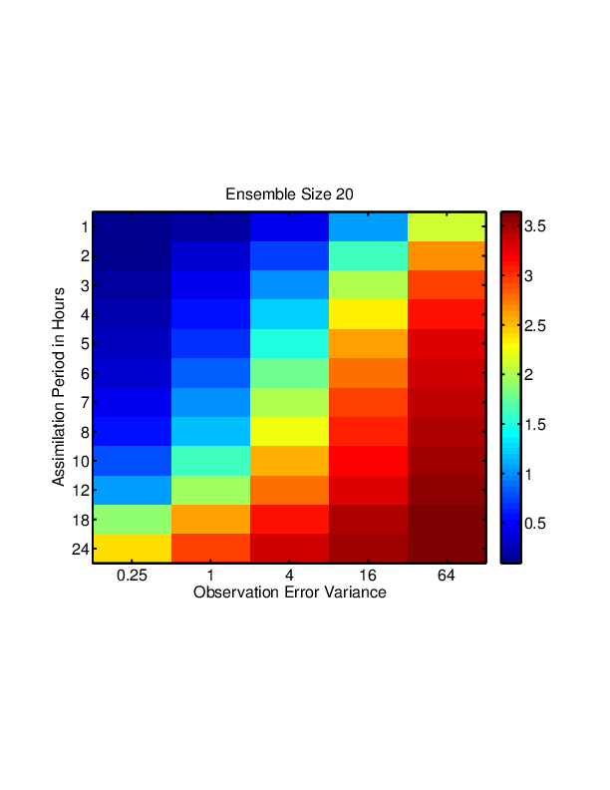
Lorenz96 Identity Observations Summary (N=20)
RMSE for Best GC
2
1

Slide 89
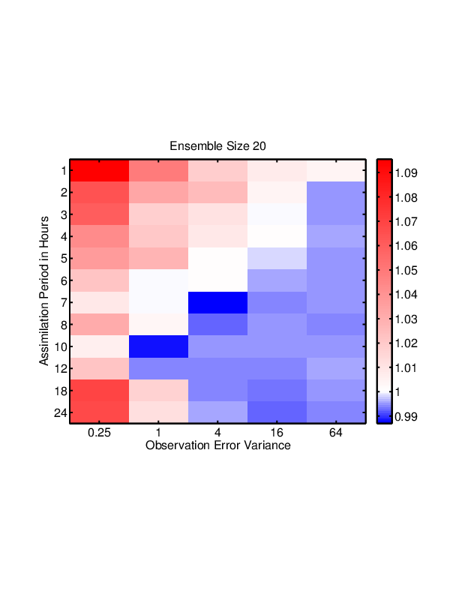
Lorenz96 Identity Observations Summary (N=20)
RMSE for Best GC
CER RMSE / Best GC RMSE: Post
2
2
1
1

Slide 90
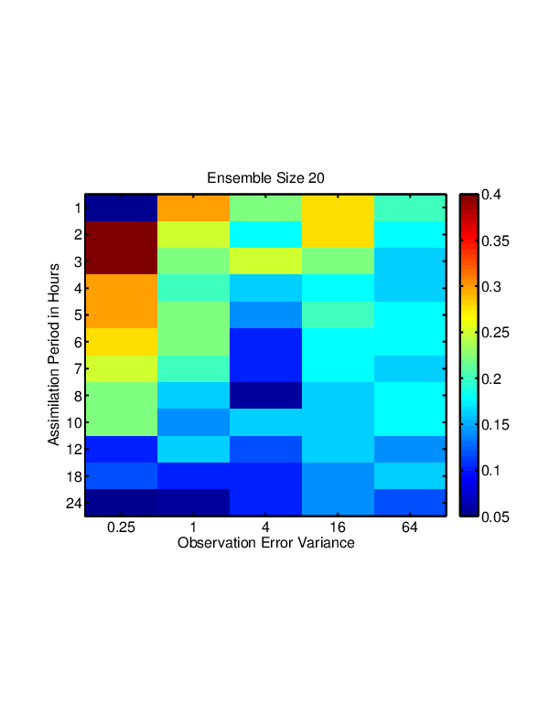
Lorenz96 Identity Observations Summary (N=20)
GC Halfwidth for Best RMSE
CER RMSE / Best GC RMSE: Post
2
2
1
1

Slide 91
L96 Case 3: Integral Observations
Each observation is average of grid point plus its nearest 8 neighbors on both side; total of 17 points.
(Something like a radiance observation.)

Slide 92
Case 3: Integral Observations
Each observation is average of grid point plus its nearest 8 neighbors on both side; total of 17 points.
(Something like a radiance observation.)
Error variance 0.0625.
Assimilate every standard model timestep.

Slide 93
Case 3: Integral Observations
Compare Correlation Error Reduction to Gaspari Cohn Localization
Ensemble Size 20

Slide 94
Approximate Localization: Observing Average of 17 States
Ensemble Size 20

Slide 95
Approximate Localization: Observing Average of 17 States
Ensemble Size 20 Plus localization for observations

Slide 96
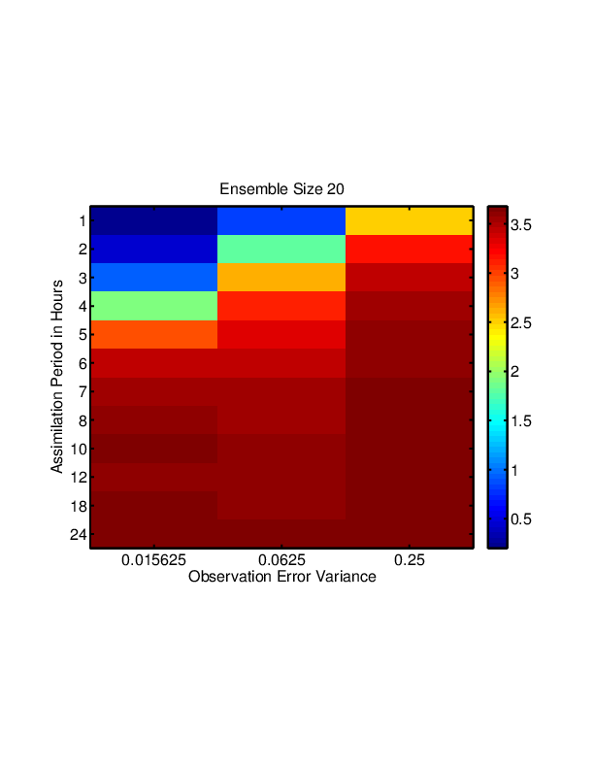
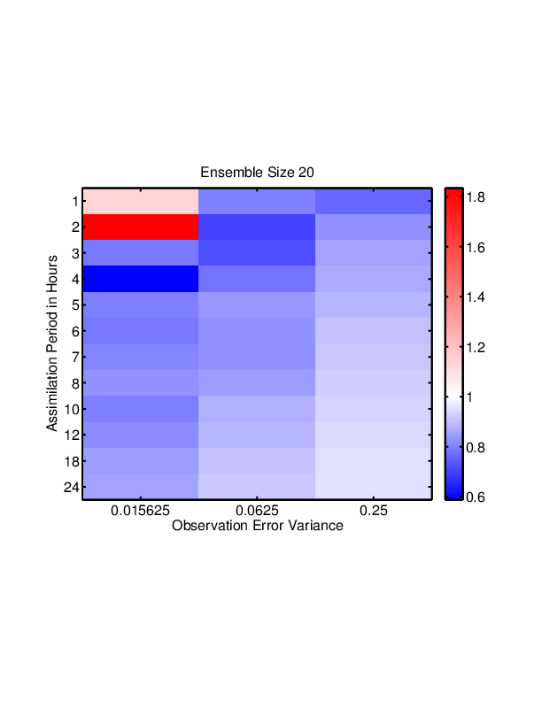
Lorenz96 Integral Observations Summary (N=20)
RMSE for Best GC
CER RMSE / Best GC RMSE: Post
*
*

Slide 97
Localization Method 5: Empirical Localization Function (ELF)
Work with Lili Lei and Jeff Whitaker
Find localization that gives least error compared to known true state in OSSE.
No a priori relation to sampling error.

Slide 98
Localization Method 5: Empirical Localization Function (ELF)
Have output from an OSSE.
Know prior ensemble and truth for each state variable.

Slide 99
Localization Method 5: Empirical Localization Function (ELF)
Have output from an OSSE.
Know prior ensemble and truth for each state variable.
Can get truth & prior ensemble for any potential observations.

Slide 100
Localization Method 5: Empirical Localization Function (ELF)
Estimate localization for set of observations and subset of state variables.
e.g. state variables at various horizontal distances from observations.

Slide 101
Localization Method 5: Empirical Localization Function (ELF)
Example: how to localize impact of temperature observations (4 shown) on a U state variable that is between 600 and 800 km distant.

Slide 102
Localization Method 5: Empirical Localization Function (ELF)
Given observational error variance, can compute expected ensemble mean increment for state.
Plot this vs prior state truth - ensemble mean.

Slide 103
Localization Method 5: Empirical Localization Function (ELF)
Do this for all state variables in subset.

Slide 104
Localization Method 5: Empirical Localization Function (ELF)
Do this for all state variables in subset.

Slide 105
Localization Method 5: Empirical Localization Function (ELF)
Do this for all state variables in subset.

Slide 106
Localization Method 5: Empirical Localization Function (ELF)
Find a least squares fit.
Slope is .
Least squares minimizes:
Same as minimizing
Posterior mean

Slide 107
Localization Method 5: Empirical Localization Function (ELF)
Find that minimizes the RMS difference between the posterior ensemble mean for x and the true value over this subset.
This can be computed from the output of the OSSE.
Can then use this localization in a new OSSE for all (y, x) in the subset.
Call the values of localization for all subsets an
Empirical Localization Function (ELF).

Slide 108
Localization Method 5: Empirical Localization Function (ELF)
Start with a climatological
ensemble.
Do set of 6000-step OSSEs.
(only use last 5000 steps).
First has no localization.
Compute ELF from each.
Use ELF for next OSSE.
No Localization
ELF1
ELF2
ELF3
ELF4
ELF5

Slide 109
Comparing Localization Methods
Gaspari Cohn: Must be tuned.
Optimal: Very expensive to tune.
Global Group Filter: Not as expensive. Assumes sampling erroneous model can determine localization.
Correlation Error Reduction: Moderately expensive. Assumes sampling error leads to need for localization. Include background information.
Empirical Localization Functions: Expensive to tune. Fits best analysis a posteriori. Not optimal for cycled.

Slide 110
Observing all State every 12 Hours, Error Variance 1, N=20
RMS Error
Localization

Slide 111
Observing all State every 12 Hours, Error Variance 1, N=20
RMS Error
Localization

Slide 112
Observing all State every 12 Hours, Error Variance 1, N=20
RMS Error
Localization

Slide 113
Observing all State every 12 Hours, Error Variance 1, N=20
RMS Error
Localization

Slide 114
Observing all State every 12 Hours, Error Variance 1, N=20
RMS Error
Localization

Slide 115
Observing all State every Hour, Error Variance 16, N=20
RMS Error
Localization

Slide 116
Observing all State every Hour, Error Variance 16, N=20
RMS Error
Localization

Slide 117
Observing all State every Hour, Error Variance 16, N=20
RMS Error
Localization

Slide 118
Observing all State every Hour, Error Variance 16, N=20
RMS Error
Localization

Slide 119
Observing all State every Hour, Error Variance 16, N=20
RMS Error
Localization

Slide 120
Low-Order Dry Dynamical Core
Evolution of surface pressure field every 12 hours.
Has baroclinic instability: storms move east in midlatitudes.
Notes:
Slide 7: GPS occultation forward operators
Non-local refractivity : (Sokolovskiy et al., MWR 133, 2200-2212)
NEED DETAILS OF ALGORITHM step size???
upper limits
grid pictures for different latitudes
Three pictures exist: ~jla/talks_and_meetings/2009/ams/cam_gps_talk/gps_lat*
Expect minor differences with coarse grid, larger near poles

Slide 121
Low-Order Dry Dynamical Core
Evolution of surface pressure field every 12 hours.
Has baroclinic instability: storms move east in midlatitudes.
Notes:
Slide 7: GPS occultation forward operators
Non-local refractivity : (Sokolovskiy et al., MWR 133, 2200-2212)
NEED DETAILS OF ALGORITHM step size???
upper limits
grid pictures for different latitudes
Three pictures exist: ~jla/talks_and_meetings/2009/ams/cam_gps_talk/gps_lat*
Expect minor differences with coarse grid, larger near poles

Slide 122
Low-Order Dry Dynamical Core
Evolution of surface pressure field every 12 hours.
Has baroclinic instability: storms move east in midlatitudes.
Notes:
Slide 7: GPS occultation forward operators
Non-local refractivity : (Sokolovskiy et al., MWR 133, 2200-2212)
NEED DETAILS OF ALGORITHM step size???
upper limits
grid pictures for different latitudes
Three pictures exist: ~jla/talks_and_meetings/2009/ams/cam_gps_talk/gps_lat*
Expect minor differences with coarse grid, larger near poles

Slide 123
Low-Order Dry Dynamical Core
Evolution of surface pressure field every 12 hours.
Has baroclinic instability: storms move east in midlatitudes.
Notes:
Slide 7: GPS occultation forward operators
Non-local refractivity : (Sokolovskiy et al., MWR 133, 2200-2212)
NEED DETAILS OF ALGORITHM step size???
upper limits
grid pictures for different latitudes
Three pictures exist: ~jla/talks_and_meetings/2009/ams/cam_gps_talk/gps_lat*
Expect minor differences with coarse grid, larger near poles

Slide 124
Low-Order Dry Dynamical Core
Evolution of surface pressure field every 12 hours.
Has baroclinic instability: storms move east in midlatitudes.
Notes:
Slide 7: GPS occultation forward operators
Non-local refractivity : (Sokolovskiy et al., MWR 133, 2200-2212)
NEED DETAILS OF ALGORITHM step size???
upper limits
grid pictures for different latitudes
Three pictures exist: ~jla/talks_and_meetings/2009/ams/cam_gps_talk/gps_lat*
Expect minor differences with coarse grid, larger near poles

Slide 125
Low-Order Dry Dynamical Core
Evolution of surface pressure field every 12 hours.
Has baroclinic instability: storms move east in midlatitudes.
Notes:
Slide 7: GPS occultation forward operators
Non-local refractivity : (Sokolovskiy et al., MWR 133, 2200-2212)
NEED DETAILS OF ALGORITHM step size???
upper limits
grid pictures for different latitudes
Three pictures exist: ~jla/talks_and_meetings/2009/ams/cam_gps_talk/gps_lat*
Expect minor differences with coarse grid, larger near poles

Slide 126
Low-Order Dry Dynamical Core
Evolution of surface pressure field every 12 hours.
Has baroclinic instability: storms move east in midlatitudes.
Notes:
Slide 7: GPS occultation forward operators
Non-local refractivity : (Sokolovskiy et al., MWR 133, 2200-2212)
NEED DETAILS OF ALGORITHM step size???
upper limits
grid pictures for different latitudes
Three pictures exist: ~jla/talks_and_meetings/2009/ams/cam_gps_talk/gps_lat*
Expect minor differences with coarse grid, larger near poles

Slide 127
Low-Order Dry Dynamical Core
Evolution of surface pressure field every 12 hours.
Has baroclinic instability: storms move east in midlatitudes.
Notes:
Slide 7: GPS occultation forward operators
Non-local refractivity : (Sokolovskiy et al., MWR 133, 2200-2212)
NEED DETAILS OF ALGORITHM step size???
upper limits
grid pictures for different latitudes
Three pictures exist: ~jla/talks_and_meetings/2009/ams/cam_gps_talk/gps_lat*
Expect minor differences with coarse grid, larger near poles

Slide 128
Low-Order Dry Dynamical Core
Evolution of surface pressure field every 12 hours.
Has baroclinic instability: storms move east in midlatitudes.
Notes:
Slide 7: GPS occultation forward operators
Non-local refractivity : (Sokolovskiy et al., MWR 133, 2200-2212)
NEED DETAILS OF ALGORITHM step size???
upper limits
grid pictures for different latitudes
Three pictures exist: ~jla/talks_and_meetings/2009/ams/cam_gps_talk/gps_lat*
Expect minor differences with coarse grid, larger near poles

Slide 129
Low-Order Dry Dynamical Core
Evolution of surface pressure field every 12 hours.
Has baroclinic instability: storms move east in midlatitudes.
Notes:
Slide 7: GPS occultation forward operators
Non-local refractivity : (Sokolovskiy et al., MWR 133, 2200-2212)
NEED DETAILS OF ALGORITHM step size???
upper limits
grid pictures for different latitudes
Three pictures exist: ~jla/talks_and_meetings/2009/ams/cam_gps_talk/gps_lat*
Expect minor differences with coarse grid, larger near poles

Slide 130
Low-Order Dry Dynamical Core: Grid
30x60 horizontal grid, 5 levels.
Surface pressure, temperature, wind components.
28,800 variables.
Notes:
Slide 7: GPS occultation forward operators
Non-local refractivity : (Sokolovskiy et al., MWR 133, 2200-2212)
NEED DETAILS OF ALGORITHM step size???
upper limits
grid pictures for different latitudes
Three pictures exist: ~jla/talks_and_meetings/2009/ams/cam_gps_talk/gps_lat*
Expect minor differences with coarse grid, larger near poles

Slide 131
Low-Order Dry Dynamical Core: Observations
Observe every 12 hours for 200 days.
Observe all 16 variables in 180 columns shown.
Error SD: Ps=2hPa, T=3K, winds=3m/s.
Notes:
Slide 7: GPS occultation forward operators
Non-local refractivity : (Sokolovskiy et al., MWR 133, 2200-2212)
NEED DETAILS OF ALGORITHM step size???
upper limits
grid pictures for different latitudes
Three pictures exist: ~jla/talks_and_meetings/2009/ams/cam_gps_talk/gps_lat*
Expect minor differences with coarse grid, larger near poles

Slide 132
Method 4: CER for Low-Order Dry Dynamical Core
Limit observation impacts to a given halfwidth:
Reduces computational costs.
Limits number of very small correlation pairs.
Notes:
Slide 7: GPS occultation forward operators
Non-local refractivity : (Sokolovskiy et al., MWR 133, 2200-2212)
NEED DETAILS OF ALGORITHM step size???
upper limits
grid pictures for different latitudes
Three pictures exist: ~jla/talks_and_meetings/2009/ams/cam_gps_talk/gps_lat*
Expect minor differences with coarse grid, larger near poles

Slide 133
CER for Low-Order Dry Dynamical Core
Prior RMSE for Surface Pressure, 20 Member Ensemble
Notes:
Slide 7: GPS occultation forward operators
Non-local refractivity : (Sokolovskiy et al., MWR 133, 2200-2212)
NEED DETAILS OF ALGORITHM step size???
upper limits
grid pictures for different latitudes
Three pictures exist: ~jla/talks_and_meetings/2009/ams/cam_gps_talk/gps_lat*
Expect minor differences with coarse grid, larger near poles

Slide 134
CER for Low-Order Dry Dynamical Core
Prior RMSE for Level 3 Temperature, 20 Member Ensemble
Notes:
Slide 7: GPS occultation forward operators
Non-local refractivity : (Sokolovskiy et al., MWR 133, 2200-2212)
NEED DETAILS OF ALGORITHM step size???
upper limits
grid pictures for different latitudes
Three pictures exist: ~jla/talks_and_meetings/2009/ams/cam_gps_talk/gps_lat*
Expect minor differences with coarse grid, larger near poles

Slide 135
CER for Low-Order Dry Dynamical Core
Prior RMSE for Level 3 Wind, 20 Member Ensemble
Notes:
Slide 7: GPS occultation forward operators
Non-local refractivity : (Sokolovskiy et al., MWR 133, 2200-2212)
NEED DETAILS OF ALGORITHM step size???
upper limits
grid pictures for different latitudes
Three pictures exist: ~jla/talks_and_meetings/2009/ams/cam_gps_talk/gps_lat*
Expect minor differences with coarse grid, larger near poles

Slide 136
CER for Low-Order Dry Dynamical Core
Prior RMSE for Level 3 Wind, 20 Member Ensemble
Notes:
Slide 7: GPS occultation forward operators
Non-local refractivity : (Sokolovskiy et al., MWR 133, 2200-2212)
NEED DETAILS OF ALGORITHM step size???
upper limits
grid pictures for different latitudes
Three pictures exist: ~jla/talks_and_meetings/2009/ams/cam_gps_talk/gps_lat*
Expect minor differences with coarse grid, larger near poles

Slide 137
CER for Low-Order Dry Dynamical Core
Localization of Level 3 T Observation on Level 3 T State
Notes:
Slide 7: GPS occultation forward operators
Non-local refractivity : (Sokolovskiy et al., MWR 133, 2200-2212)
NEED DETAILS OF ALGORITHM step size???
upper limits
grid pictures for different latitudes
Three pictures exist: ~jla/talks_and_meetings/2009/ams/cam_gps_talk/gps_lat*
Expect minor differences with coarse grid, larger near poles

Slide 138
CER for Low-Order Dry Dynamical Core
Localization of Level 3 T Observation on Level 3 T State
Notes:
Slide 7: GPS occultation forward operators
Non-local refractivity : (Sokolovskiy et al., MWR 133, 2200-2212)
NEED DETAILS OF ALGORITHM step size???
upper limits
grid pictures for different latitudes
Three pictures exist: ~jla/talks_and_meetings/2009/ams/cam_gps_talk/gps_lat*
Expect minor differences with coarse grid, larger near poles

Slide 139
CER for Low-Order Dry Dynamical Core
Localization of Level 3 T Observation on Level 3 T State
Notes:
Slide 7: GPS occultation forward operators
Non-local refractivity : (Sokolovskiy et al., MWR 133, 2200-2212)
NEED DETAILS OF ALGORITHM step size???
upper limits
grid pictures for different latitudes
Three pictures exist: ~jla/talks_and_meetings/2009/ams/cam_gps_talk/gps_lat*
Expect minor differences with coarse grid, larger near poles

Slide 140
CER for Low-Order Dry Dynamical Core
Localization of Level 3 U Observation on PS State
Notes:
Slide 7: GPS occultation forward operators
Non-local refractivity : (Sokolovskiy et al., MWR 133, 2200-2212)
NEED DETAILS OF ALGORITHM step size???
upper limits
grid pictures for different latitudes
Three pictures exist: ~jla/talks_and_meetings/2009/ams/cam_gps_talk/gps_lat*
Expect minor differences with coarse grid, larger near poles

Slide 141
CER for Low-Order Dry Dynamical Core
Localization of PS Observation on Level 3 U State
Notes:
Slide 7: GPS occultation forward operators
Non-local refractivity : (Sokolovskiy et al., MWR 133, 2200-2212)
NEED DETAILS OF ALGORITHM step size???
upper limits
grid pictures for different latitudes
Three pictures exist: ~jla/talks_and_meetings/2009/ams/cam_gps_talk/gps_lat*
Expect minor differences with coarse grid, larger near poles

Slide 142
CER for Low-Order Dry Dynamical Core
Localization of PS Observation on Level 3 V State
Notes:
Slide 7: GPS occultation forward operators
Non-local refractivity : (Sokolovskiy et al., MWR 133, 2200-2212)
NEED DETAILS OF ALGORITHM step size???
upper limits
grid pictures for different latitudes
Three pictures exist: ~jla/talks_and_meetings/2009/ams/cam_gps_talk/gps_lat*
Expect minor differences with coarse grid, larger near poles

Slide 143
Method 5: ELF in CAM5 AGCM
Lili Lei did most of the ELF work.
Notes:
Slide 7: GPS occultation forward operators
Non-local refractivity : (Sokolovskiy et al., MWR 133, 2200-2212)
NEED DETAILS OF ALGORITHM step size???
upper limits
grid pictures for different latitudes
Three pictures exist: ~jla/talks_and_meetings/2009/ams/cam_gps_talk/gps_lat*
Expect minor differences with coarse grid, larger near poles

Slide 144
Method 5: ELF in CAM5 AGCM
Conduct OSSEs in DART/CAM system (Raeder et al. 2012).
CAM5 model:
Atmospheric component of the Community Earth System Model version 1 (CESM1; Gent et al. 2011)
Finite volume grid with approximately 2° resolution (94x144) and 30 vertical levels
Default configuration of the Atmospheric Model Intercomparison Project (AMIP; Gates 1992) protocol
Data assimilation system:
Ensemble adjustment Kalman filter (EAKF; Anderson 2001) in DART
Spatially- and temporally-varying state space adaptive inflation (Anderson 2009)
GC localization as the default
Notes:
Slide 7: GPS occultation forward operators
Non-local refractivity : (Sokolovskiy et al., MWR 133, 2200-2212)
NEED DETAILS OF ALGORITHM step size???
upper limits
grid pictures for different latitudes
Three pictures exist: ~jla/talks_and_meetings/2009/ams/cam_gps_talk/gps_lat*
Expect minor differences with coarse grid, larger near poles

Slide 145
RMSE with GC Localization
RMSEs for temperature and zonal wind are averaged globally (GL), in the southern hemisphere (SH), tropics (TP) and northern hemisphere (NH).
GC0.4 has smallest globally averaged RMSE, so 0.4 is chosen as the best halfwidth.
Some RMSEs computed for SH, TP and NH separately are smallest for other halfwidths; tuning the GC halfwidth is complex.
Notes:
Slide 7: GPS occultation forward operators
Non-local refractivity : (Sokolovskiy et al., MWR 133, 2200-2212)
NEED DETAILS OF ALGORITHM step size???
upper limits
grid pictures for different latitudes
Three pictures exist: ~jla/talks_and_meetings/2009/ams/cam_gps_talk/gps_lat*
Expect minor differences with coarse grid, larger near poles

Slide 146
Horizontal and Vertical ELFs for CAM
Empirical localizations (black dots) computed separately for temperature, u&v winds at ten levels (30 dots per distance).
A z-test to assess significance.
A cubic spline (blue line) gives final localization function (ELFSP).
The horizontal ELFSP is smaller than the GC0.2 and GC0.4 at small separations and has a wider tail than GC0.2 and GC0.4.
The vertical ELFSP is much broader than the GC0.2 and GC0.4.
The horizontal and vertical ELFSPs are used in a subsequent OSSE (ELFOne).
Horizontal
Vertical
Notes:
Slide 7: GPS occultation forward operators
Non-local refractivity : (Sokolovskiy et al., MWR 133, 2200-2212)
NEED DETAILS OF ALGORITHM step size???
upper limits
grid pictures for different latitudes
Three pictures exist: ~jla/talks_and_meetings/2009/ams/cam_gps_talk/gps_lat*
Expect minor differences with coarse grid, larger near poles

Slide 147
Horizontal/vertical ELFs varying by geographic regions
Horizontal and vertical ELFSPs are computed for SH, TP and NH separately.
Horizontal and vertical ELFSPs varying by region are used in a subsequent OSSE (ELFReg).
Notes:
Slide 7: GPS occultation forward operators
Non-local refractivity : (Sokolovskiy et al., MWR 133, 2200-2212)
NEED DETAILS OF ALGORITHM step size???
upper limits
grid pictures for different latitudes
Three pictures exist: ~jla/talks_and_meetings/2009/ams/cam_gps_talk/gps_lat*
Expect minor differences with coarse grid, larger near poles

Slide 148
Temperature RMSE Averaged in NH and TP
ELFReg has slightly smaller temperature RMSE than ELFOne in NH and SH.
ELFReg has smaller temperature RMSE than ELFOne in TP.
ELFReg has smaller globally averaged RMSE than ELFOne.
Notes:
Slide 7: GPS occultation forward operators
Non-local refractivity : (Sokolovskiy et al., MWR 133, 2200-2212)
NEED DETAILS OF ALGORITHM step size???
upper limits
grid pictures for different latitudes
Three pictures exist: ~jla/talks_and_meetings/2009/ams/cam_gps_talk/gps_lat*
Expect minor differences with coarse grid, larger near poles

Slide 149
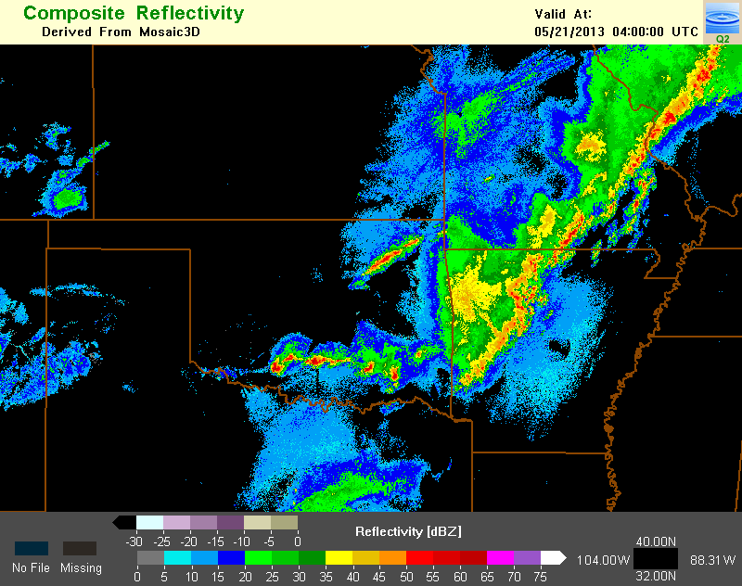
Is different localization needed for different weather? Raining versus not raining.
Method 5: ELFs in WRF Regional Model
Notes:
Slide 7: GPS occultation forward operators
Non-local refractivity : (Sokolovskiy et al., MWR 133, 2200-2212)
NEED DETAILS OF ALGORITHM step size???
upper limits
grid pictures for different latitudes
Three pictures exist: ~jla/talks_and_meetings/2009/ams/cam_gps_talk/gps_lat*
Expect minor differences with coarse grid, larger near poles

Slide 150
ELFs in WRF Regional Model
WRF model V3.3.1 :
CONUS domain with horizontal grid spacing 15 km, 40 vertical layers and model top at 50 hPa
Model physics: RRTMG long wave and short wave radiation schemes, Thompson 2-moment microphysics scheme, Noah land surface model, MYJ PBL scheme, and Tiedtke cumulus scheme
Data assimilation system:
EAKF in DART
Spatially- and temporally-varying state space adaptive inflation
GC localization of halfwidth 0.1 radians as the default
Notes:
Slide 7: GPS occultation forward operators
Non-local refractivity : (Sokolovskiy et al., MWR 133, 2200-2212)
NEED DETAILS OF ALGORITHM step size???
upper limits
grid pictures for different latitudes
Three pictures exist: ~jla/talks_and_meetings/2009/ams/cam_gps_talk/gps_lat*
Expect minor differences with coarse grid, larger near poles

Slide 151
ELFs in WRF Regional Model
Number of pairs
Number of pairs
Localization (-) / Correlation (- -)
Localization (-) / Correlation (- -)
The ELFs for non-precipitating regions (ELFNP) have similar shape to GC0.1, but ELFNP of u-wind is smaller than GC0.1 for small separations.
The ELFs for precipitating regions (ELFP) are narrower than GC0.1 and ELFNP.
The correlation coefficient of ELF for precipitating regions decreases faster than for non-precipitating regions.
Notes:
Slide 7: GPS occultation forward operators
Non-local refractivity : (Sokolovskiy et al., MWR 133, 2200-2212)
NEED DETAILS OF ALGORITHM step size???
upper limits
grid pictures for different latitudes
Three pictures exist: ~jla/talks_and_meetings/2009/ams/cam_gps_talk/gps_lat*
Expect minor differences with coarse grid, larger near poles

Slide 152
ELFs in WRF Regional Model
Number of pairs
Number of pairs
x 10⁷
x 10⁷
1.5
1.5
Localization (-) / Correlation (- -)
Localization (-) / Correlation (- -)
The vertical ELFs for precipitating regions generally have larger localizations.
The vertical ELFP of temperature decreases more quickly with height than for u- and v-winds between 4 and 10 km.
The correlation coefficient of ELF for precipitating regions is larger.
Notes:
Slide 7: GPS occultation forward operators
Non-local refractivity : (Sokolovskiy et al., MWR 133, 2200-2212)
NEED DETAILS OF ALGORITHM step size???
upper limits
grid pictures for different latitudes
Three pictures exist: ~jla/talks_and_meetings/2009/ams/cam_gps_talk/gps_lat*
Expect minor differences with coarse grid, larger near poles

Slide 153
ELFs in WRF Regional Model
Exp. name | Applied localization function
GC0.1 | GC localization function with half-width of 0.1 radians.
ELFOneA | One horizontal and one vertical ELFF that are computed from the output of GC0.1.
ELFOnePN | From the output of GC0.1, two horizontal and two vertical ELFFs that vary with precipitating and non-precipitating regions.
ELFObsPN | From the output of GC0.1, one horizontal and one vertical ELFF of temperature and one horizontal and one vertical ELFF of u- and v-wind for precipitating regions, and similarly four ELFFs for non-precipitating regions.
Notes:
Slide 7: GPS occultation forward operators
Non-local refractivity : (Sokolovskiy et al., MWR 133, 2200-2212)
NEED DETAILS OF ALGORITHM step size???
upper limits
grid pictures for different latitudes
Three pictures exist: ~jla/talks_and_meetings/2009/ams/cam_gps_talk/gps_lat*
Expect minor differences with coarse grid, larger near poles

Slide 154
Average Temperature RMSE for GC0.1 and ELFs
ELFOneA yields slightly smaller (but statistically significant) RMSE than GC0.1.
ELFOnePN has slightly smaller (but statistically significant) RMSE than GC0.1 and ELFOneA, thus the advantages of varying localization for precipitation and non-precipitating regions are demonstrated.
But the localization functions varying by observation types (ELFObsPN) do not show additional benefits than ELFOnePN.
Notes:
Slide 7: GPS occultation forward operators
Non-local refractivity : (Sokolovskiy et al., MWR 133, 2200-2212)
NEED DETAILS OF ALGORITHM step size???
upper limits
grid pictures for different latitudes
Three pictures exist: ~jla/talks_and_meetings/2009/ams/cam_gps_talk/gps_lat*
Expect minor differences with coarse grid, larger near poles

Slide 155
Conclusions
Many methods for estimating localization.
Often produce similar results.
Good localization important for small ensembles.
May not matter so much for tails, larger ensembles.
Methods can guide localization for remote sensing.
Automated methods mostly ignore balance issues.
For operational NWP, may be small but important.

Slide 156
Learn more about DART at:
www.image.ucar.edu/DAReS/DART
Anderson, J., Hoar, T., Raeder, K., Liu, H., Collins, N., Torn, R., Arellano, A., 2009: The Data Assimilation Research Testbed: A community facility.
BAMS, 90, 1283—1296, doi: 10.1175/2009BAMS2618.1

